Slide 1


Manuel Luján Vilchez
22/10/2024

Slide 2

Outline
Executive Summary
Introduction
Methodology
Results
Conclusion
Appendix

Slide 3
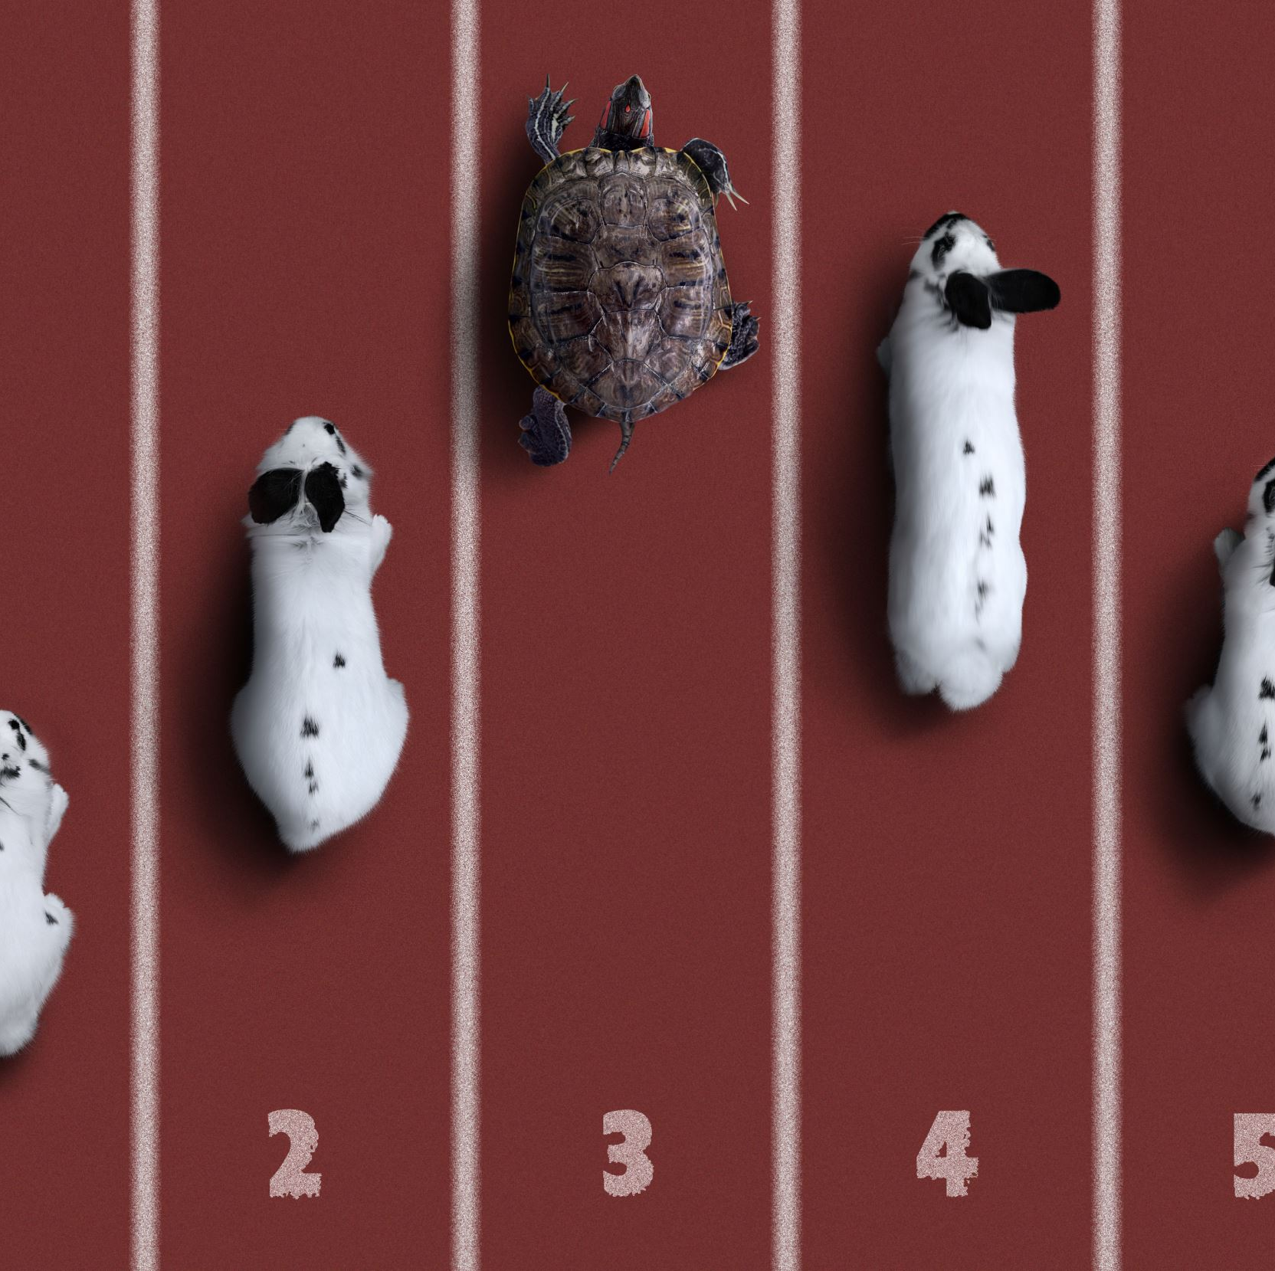
Executive Summary
Project Overview: Prediction of the successful landing of Falcon 9’s first stage.
Objective: Reduce launch costs by predicting Falcon 9 reusability.
Technologies Used: Python, Scikit-learn, Pandas, Folium, Plotly Dash.

Slide 4
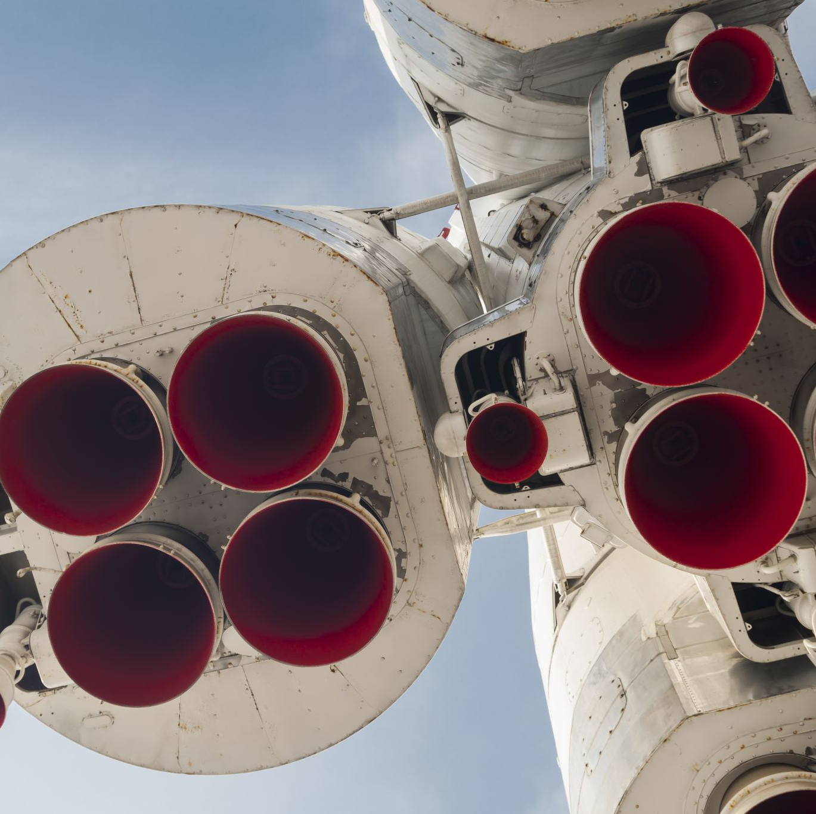
Introduction
Context: Falcon 9 is a reusable rocket designed to reduce the costs of space missions.
Problem: The reuse of Falcon 9 depends on the successful landing of its first stage.
Project Goal: Build machine learning models to predict whether the Falcon 9 will successfully land, using historical SpaceX launch data.

Slide 5

Section 1

Slide 6
Methodology
Executive Summary
Data collection methodology:
SpaceX launch data was sourced from publicly available records, including launch dates, payloads, orbits, and landing outcomes.
Perform data wrangling
Missing values were handled, and categorical variables were one-hot encoded for modeling.
Perform exploratory data analysis (EDA) using visualization and SQL
Perform interactive visual analytics using Folium and Plotly Dash
Perform predictive analysis using classification models
Data was normalized, standardized, and split into training and testing sets for model evaluation.

Slide 7
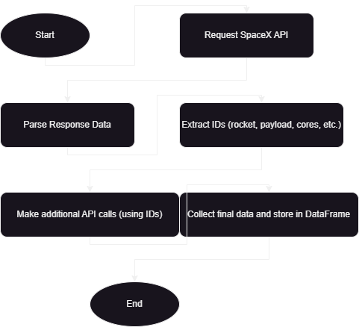

Data Wrangling
API Flow:
Send API Request to SpaceX API endpoints to retrieve historical launch data.
Process Response by parsing JSON output to extract relevant fields.
Store Data into a structured format for further analysis.
For a detailed demonstration of API calls, including code and outcomes, you can access the GitHub repository ([here]).

Slide 8
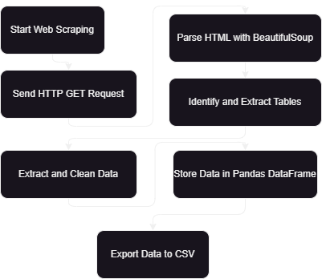
Data Collection - Scraping
Scraping Flow:
Request Data: Send an HTTP GET request to the Wikipedia page.
Extract Information: Loop through table rows and extract relevant columns (flight number, payload, etc.).
Store Data: Save the extracted data into a Pandas DataFrame for analysis.
For a detailed demonstration of API calls, including code and outcomes, you can access the GitHub repository ([here]).
Parse HTML: Use BeautifulSoup to parse the page and locate the launch records table.

Slide 9
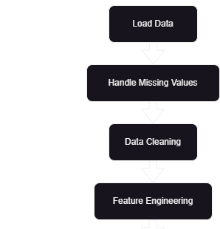
Data Wrangling
Load Data: Import the Falcon 9 launch data from CSV or API response into a Pandas DataFrame.
Handle Missing Values: Identify and fill or remove missing data, such as payload mass or landing pad details.
Data Cleaning: Convert data types, standardize column formats, and normalize numerical values.
Feature Engineering: Extract relevant features like booster version, launch outcome, and landing status.
Save Processed Data: Export the cleaned and processed data for further analysis.
For a detailed demonstration of API calls, including code and outcomes, you can access the GitHub repository ([here]).

Slide 10
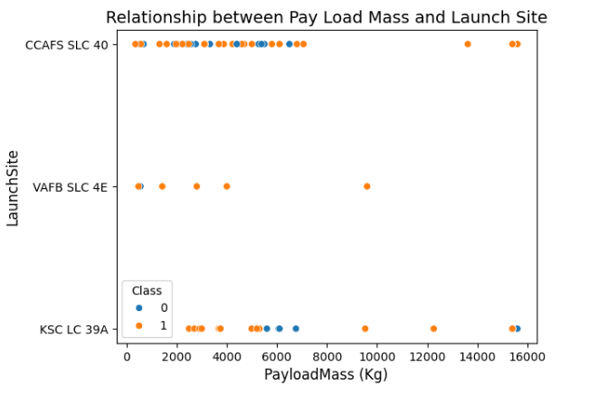
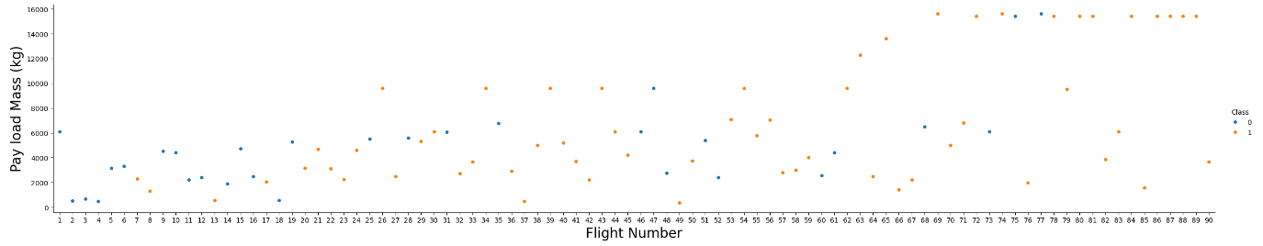
EDA with Data Visualization 1/2
Charts Summary:
Correlation Heatmap:
Purpose: To identify relationships between variables like payload mass, flight count, and block type, helping in feature selection.
Scatter Plot:
Purpose: To visualize the impact of payload mass on landing success, exploring how weight affects mission outcomes.

Slide 11
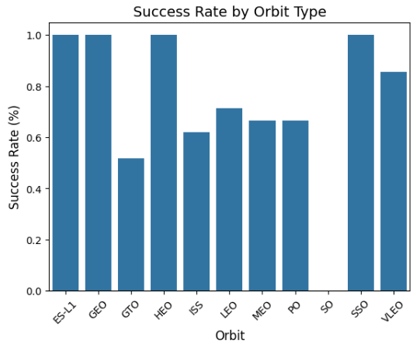
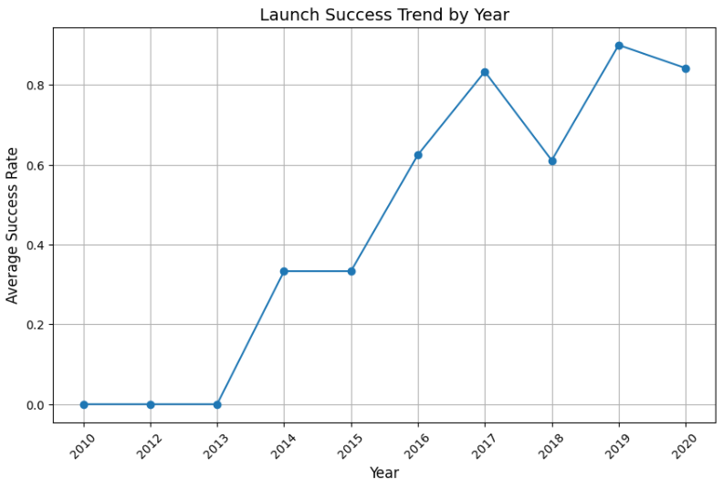
EDA with Data Visualization 2/2
Charts Summary:
Bar Chart:
Purpose: To show the distribution of launches by site and success/failure rates, identifying key trends.
Line Chart:
Purpose: To track Falcon 9 launch success over time, highlighting improvements in technology and performance.

Slide 12
EDA with SQL
Displayed unique launch sites.
Displayed 5 records where launch sites start with 'CCA'.
Calculated total payload mass for NASA (CRS) missions.
Calculated average payload mass for F9 v1.1 booster.
Listed date of first successful landing on a ground pad.
Listed boosters with successful drone ship landings and payloads between 4000-6000 kg.
Counted successful and failed landing outcomes.
Listed boosters carrying the maximum payload.
Listed records of failed drone ship landings in 2015.
Ranked landing outcomes between 2010-2017 in descending order.

Slide 13
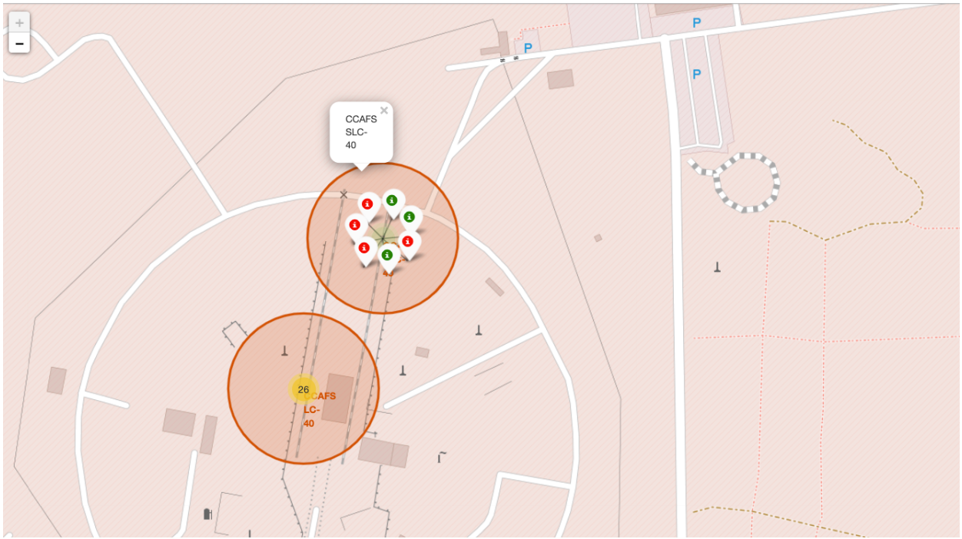
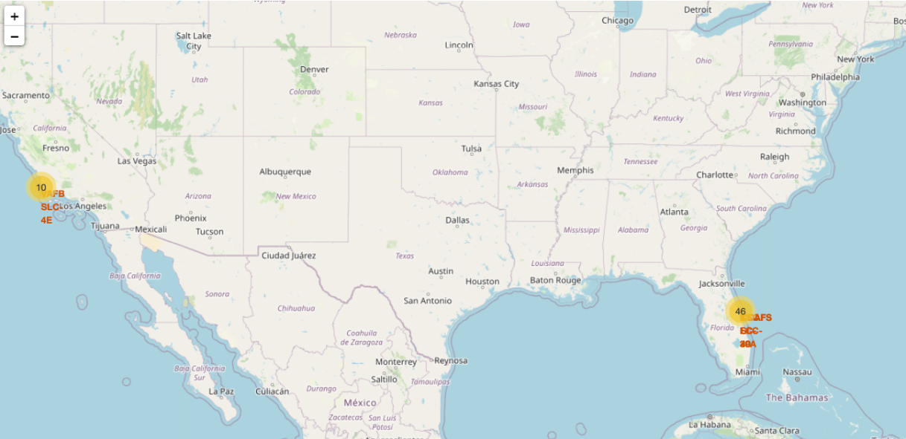
Build an Interactive Map with
Markers: To identify launch site locations.
Circles: To show proximity to cities, railways, highways, and coastlines.
Lines: To illustrate distances from launch sites to important infrastructures.

Slide 14
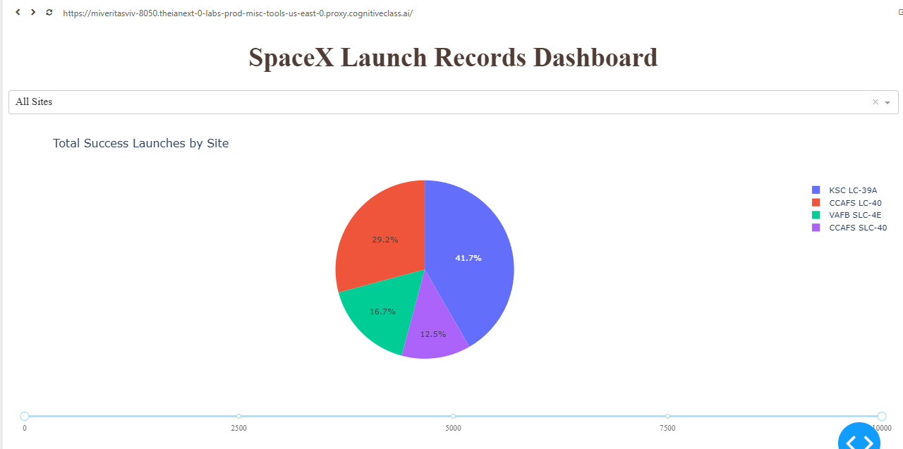
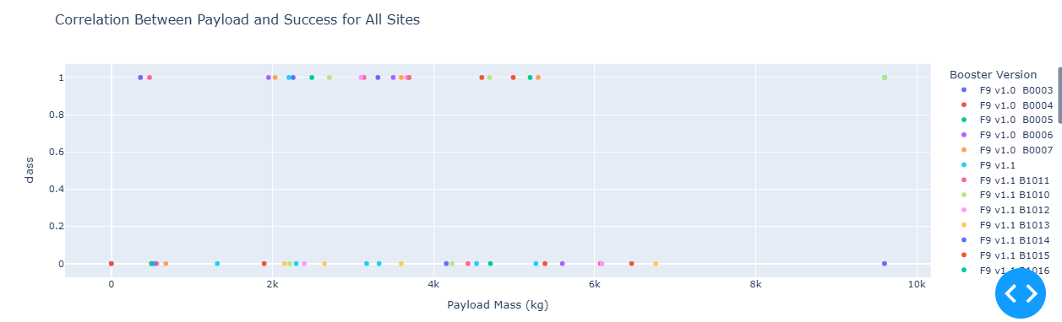
Build a Dashboard with Plotly
Added Plots:
Pie Chart: Visualizes success/failure rates by launch site.
Scatter Plot: Shows payload vs. launch outcome, colored by booster version.
Interactions:
Dropdown: Select launch site.
Range Slider: Filter by payload mass.

Slide 15
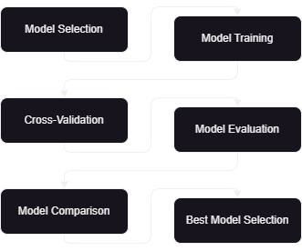
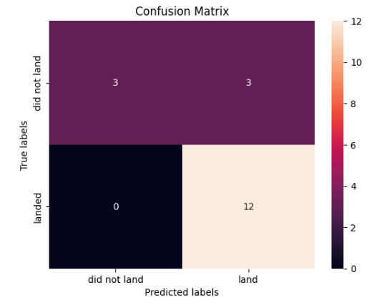
Predictive Analysis (Classification)
Model Selection: Built Logistic Regression, SVM, Decision Tree, and KNN models.
Training & Evaluation: Used cross-validation, evaluated with accuracy and confusion matrix.
Results: All models achieved the same accuracy (83.33%). Further tuning required for improvement.

Slide 16

Results
Best Model: Compared Logistic Regression, SVM, Decision Tree, and KNN.
Model Performance: Logistic Regression and SVM achieved the highest test accuracy (83.3%).
Confusion Matrix: Evaluated the accuracy of predictions by analyzing true positives and negatives, with focus on reducing false classifications.

Slide 17

Section 2

Slide 18
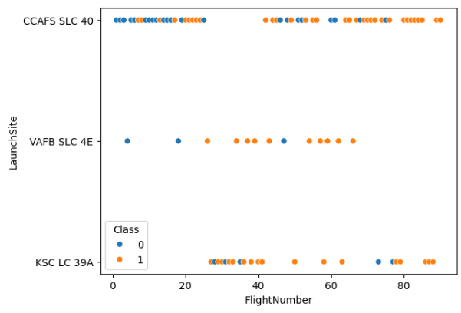
Flight Number vs. Launch Site
Key Insights:
This scatter plot displays the relationship between the Flight Number and the Launch Sites used by SpaceX.
The color of each point represents the success or failure of the launch, where green indicates success, and red indicates failure.
The chart shows which launch sites have been most frequently used and how successful launches have been at each site.
Patterns can be observed in how frequently certain sites have been used for higher flight numbers or specific mission types.
Supporting Text:
"This chart illustrates the distribution of SpaceX launches across different launch sites. It highlights the number of flights for each site and how launch success rates vary by location. Key sites and their success outcomes are visualized, offering insights into site usage and launch performance over time."

Slide 19
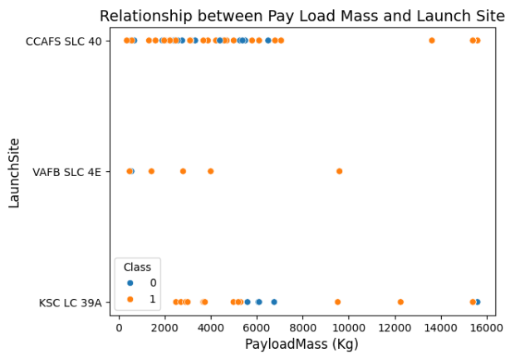
Payload vs. Launch Site
Key Insights:
This scatter plot illustrates the relationship between the Payload Mass (in kilograms) and the Launch Sites used by SpaceX.
Each point represents a specific launch, with the color indicating whether the launch was a success (green) or failure (red).
The chart helps identify which launch sites handled the heaviest payloads and their associated success rates.
Patterns in payload size distribution across different launch sites can be observed, helping assess the capacity and reliability of each site for various payload masses.
Supporting Text:
"This chart provides a comparison of SpaceX launch sites based on the payload mass they handled and the outcomes of these missions. It highlights how different sites perform with varying payload sizes, offering insights into the correlation between payload mass and launch success rates."

Slide 20
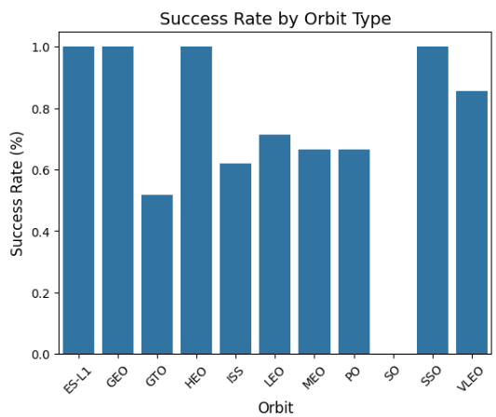
Success Rate vs. Orbit Type
Key Insights:
This bar chart showcases the success rates of SpaceX launches for different Orbit Types.
Each bar represents an orbit type (e.g., LEO, GTO, ISS), with the height indicating the proportion of successful launches compared to total attempts for that orbit.
The chart highlights which orbit types have the highest reliability and which are more challenging for successful launches.
It helps understand the effectiveness of SpaceX's technology for various mission profiles based on orbit type.
Supporting Text:
"This chart compares the success rates of SpaceX launches across different orbit types, offering insights into how SpaceX performs in various mission profiles. Higher success rates in certain orbits may reflect advancements in technology or mission-specific optimizations."

Slide 21
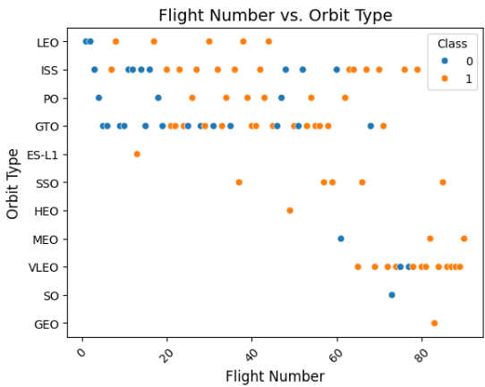
Flight Number vs. Orbit Type
Key Insights:
This scatter plot visualizes the relationship between Flight Number and Orbit Type.
Each point represents a SpaceX launch, with its position indicating the flight number and the orbit type achieved.
The chart helps track how SpaceX has deployed different orbit types over time, as indicated by increasing flight numbers.
It provides a view of how the company's launch frequency into various orbits has evolved and identifies trends in their mission focus.
Supporting Text:
"This scatter plot shows the distribution of SpaceX launches across different orbit types based on flight numbers, allowing us to observe how SpaceX's focus on specific orbits has developed over time."

Slide 22
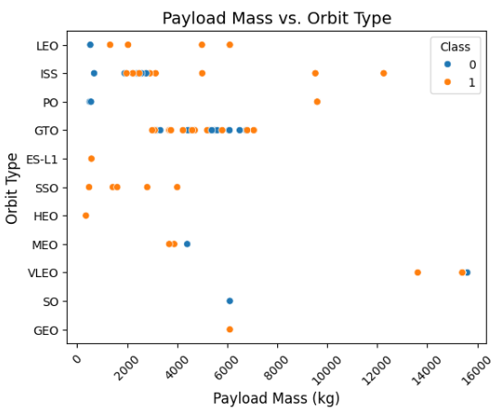
Payload vs. Orbit Type
Key Insights:
This scatter plot displays the relationship between Payload Mass and Orbit Type.
Each point represents a SpaceX launch, showing how different payload masses were delivered to various orbit types.
The chart highlights payload distribution across orbit types, helping us identify which orbits typically carry larger or smaller payloads.
It also provides insight into the mission types and payload capabilities for different orbit categories.
Supporting Text:
"This plot illustrates how SpaceX has deployed payloads of varying masses into different orbit types, offering insights into the range and capacity of payloads for each orbit."

Slide 23
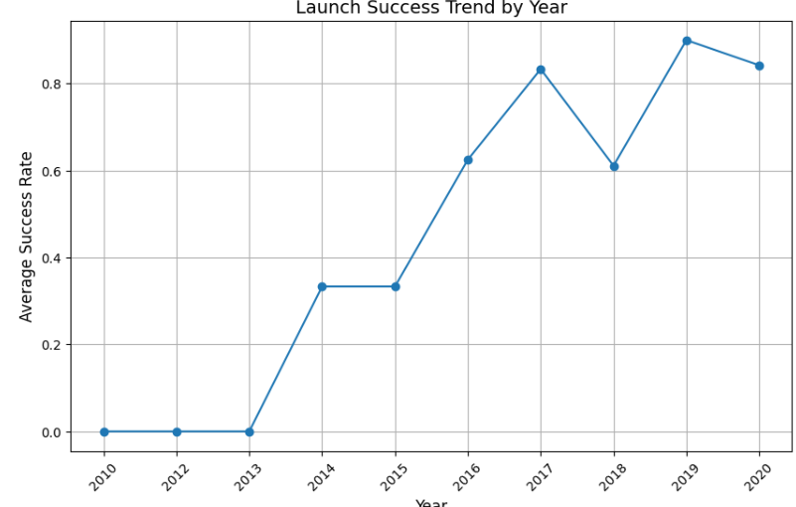
Launch Success Yearly Trend
Query Result:
Displays the number of successful launches per year.
Shows a consistent upward trend in success rates.
Supporting Text:
"The increase in successful launches reflects SpaceX’s technological advancements and mission reliability. Key milestones include the development of reusable rockets and securing government and commercial contracts."

Slide 24
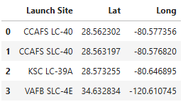
All Launch Site Names
Query Result:
Identified four unique launch sites used by SpaceX.
Supporting Text:
"These sites are strategically located to support various orbital trajectories and mission requirements. Key locations include Cape Canaveral and Vandenberg, vital for launching into different orbits."

Slide 25
Launch Site Names Begin with 'CCA'
Query Result:
The query results display 5 records where the launch site names start with 'CCA'. These launch sites include variations of the Cape Canaveral Air Force Station, demonstrating that a majority of SpaceX launches are conducted from Cape Canaveral.
Supporting Text:
"Out of all the launch sites, several are associated with Cape Canaveral, an essential location for space launches in the United States. The data retrieved shows launches from sites like CCAFS LC-40, which has been pivotal for SpaceX missions, offering proximity to the Atlantic Ocean for safe launches."

Slide 26
Total Payload Mass
Query Result:
The query results display the total payload mass carried by boosters launched by NASA. This includes all the payloads from missions associated with NASA, showing their significant contribution to SpaceX's launches over the years.
Supporting Text:
"The data highlights NASA's (KSC LC-39A) pivotal role in SpaceX missions, with substantial payloads transported across multiple launches. By analyzing this data, we can appreciate the scale of NASA's contribution to space exploration, particularly in cargo resupply and other critical missions."

Slide 27
Average Payload Mass by F9 v1.1
Query Result:
The query result shows the average payload mass carried by booster version F9 v1.1 is approximately 2928.4 kg. This value represents the typical payload capacity for missions using this version of the Falcon 9 rocket.
Supporting Text:
"The F9 v1.1 booster version, introduced with significant improvements over its predecessor, demonstrated an average payload mass of 2928.4 kg, highlighting its capability in handling medium-weight missions efficiently. This booster played a crucial role in SpaceX’s early orbital success."

Slide 28
First Successful Ground Landing Date
Query Result:
The query results indicate that the first successful landing on a ground pad occurred on December 22, 2015. This milestone is significant as it marked the beginning of SpaceX's successful attempts to recover and reuse its boosters.
Supporting Text:
"The first successful ground landing represents a critical achievement in space travel, where SpaceX demonstrated the feasibility of reusing rockets. This not only reduces costs but also revolutionizes spaceflight by enabling rapid reusability of launch vehicles, a goal set by SpaceX for long-term space exploration."

Slide 29
Successful Drone Ship Landing with Payload between 4000 and 6000
Query Result:
The query result shows a list of boosters that successfully landed on a drone ship and carried a payload mass between 4000 and 6000 kg. These boosters include specific versions of the Falcon 9, demonstrating SpaceX's capability to land heavy payloads on drone ships, enabling more efficient space operations.
Supporting Text:
"SpaceX's ability to land boosters on drone ships while carrying significant payloads, such as between 4000 and 6000 kg, showcases their technological advancements. These successful landings allow for greater flexibility in launch and recovery operations, further contributing to reducing space mission costs and advancing space travel efficiency."

Slide 30
Total Number of Successful and Failure Mission Outcomes
Query Result:
The query result presents the total count of successful and failed mission outcomes. It provides insights into the overall success rate of SpaceX missions, showing how many launches resulted in successful missions and how many encountered failure.
Supporting Text:
"The analysis of mission outcomes reveals the reliability and effectiveness of SpaceX's launch operations. A higher number of successful missions compared to failures indicates progress in technology and operational execution. Understanding these figures helps to assess SpaceX's performance and the potential areas for improvement in future missions."

Slide 31
Boosters Carried Maximum Payload
Query Result:
The boosters carrying the maximum payload mass are F9 B5 variants like B1048.4 and B1049.4, known for handling SpaceX's heaviest missions.
Supporting Text:
"F9 B5 boosters have been key in missions requiring heavy payload capacity, demonstrating their ability to handle large equipment or multiple satellites."

Slide 32
2015 Launch Records
Query Result:
The failed landing outcomes on drone ships in 2015 include booster versions such as F9 v1.1 B1012 and B1015, which were launched from the CCAFS LC-40 launch site.
Supporting Text:
"In 2015, several SpaceX missions experienced failed landings on drone ships. These attempts, while not successful, provided critical data for future missions, particularly for boosters like F9 v1.1 B1012 and B1015."

Slide 33
Rank Landing Outcomes Between 2010-06-04 and 2017-03-20
Query Result:
The ranking of landing outcomes between June 4, 2010, and March 20, 2017, shows that the most frequent outcome was "No attempt," followed by "Success (drone ship)" and "Failure (drone ship)."
Supporting Text:
"From 2010 to 2017, a significant number of missions did not attempt a landing, but over time, more successful landings on drone ships were achieved. Failures also occurred frequently during early attempts, highlighting the experimental nature of these missions."

Slide 34

Section 3

Slide 35
Launch Sites Across the Globe
The folium map displays markers indicating the locations of all SpaceX launch sites globally. Each marker represents a launch site, such as Cape Canaveral in Florida, Vandenberg in California, and others. These sites are crucial for SpaceX's global launch operations. Proximity to coastlines, railways, and cities plays a significant role in the site's selection for optimal logistical and safety purposes. The map also highlights how SpaceX strategically locates its launch sites to ensure accessibility, safety, and coverage of various orbital paths.

Slide 36
Color-Labeled Launch Outcomes on Global Map
This folium map displays color-labeled markers representing SpaceX launch outcomes at various sites. Green markers indicate successful launches, while red markers denote failures. Each marker is color-coded based on the outcome, making it easy to assess the success rate at different launch sites, such as Cape Canaveral and Vandenberg. The visual distinction helps identify high-performance sites with a greater number of successful launches, which are critical for understanding operational efficiency and reliability at specific locations. This analysis aids in planning future missions based on past outcomes.

Slide 37
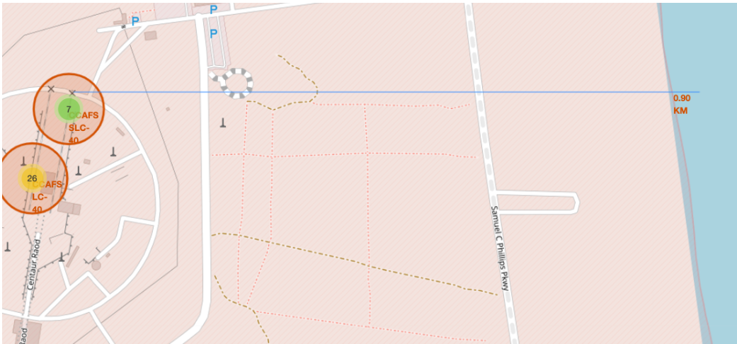
Launch Site Proximity Analysis: Railway, Highway, and Coastline
This folium map displays a selected launch site, highlighting its proximity to essential infrastructures like railways, highways, and coastlines. Each proximity is marked with a line connecting it to the launch site, with the calculated distance displayed next to each marker. This helps visualize how close the launch site is to key logistics and transportation elements, which are crucial for efficient operations, quick transport, and safety considerations. The proximity to the coastline is particularly important for safety during launches, allowing rockets to be directed over the ocean.

Slide 38

Section 4

Slide 39
Launch Success Count for All Sites
This dashboard screenshot features a pie chart representing the total launch success counts for all SpaceX launch sites. Each slice of the pie corresponds to a different launch site, visually depicting the distribution of successful launches. The chart allows for a quick comparison of which launch sites have higher success rates. This insight helps identify key sites like Cape Canaveral or Vandenberg as major contributors to SpaceX’s successful missions. Understanding the success distribution aids in strategic decisions for future launches.

Slide 40
Site with Highest Success Ratio
This dashboard screenshot presents a pie chart focusing on the launch site with the highest success ratio. The chart visually displays the proportion of successful vs. unsuccessful launches at the selected site. By analyzing this, we can conclude which launch site consistently performs the best in terms of successful missions. This finding is crucial for optimizing future launches and improving mission planning strategies at the most reliable locations.

Slide 41
Payload vs. Launch Outcome for All Sites
This dashboard screenshot showcases a scatter plot of payload mass vs. launch outcomes for all sites, with the payload range adjusted using the range slider. The plot provides insights into how payload mass influences the success rate of launches across different booster versions. By observing the scatter points, you can identify the payload ranges with the highest and lowest success rates, as well as which booster versions tend to perform better under certain payload conditions. This analysis is essential for optimizing payload management and selecting the appropriate boosters for future missions to improve launch success.

Slide 42

Section 5

Slide 43
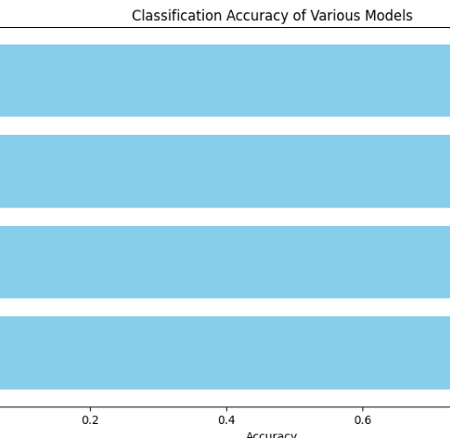
Classification Accuracy
Model Accuracy Calculation: The accuracy of four classification models was calculated:
Logistic Regression: 83.33%
SVM: 83.33%
Decision Tree: 88.89%
KNN: 83.33%
Bar Chart Visualization: A bar chart was created to visually compare the accuracy of these models, allowing for easy identification of which model performs best.
Highest Accuracy Model: From the analysis, the Decision Tree model has the highest accuracy at 88.89%.

Slide 44
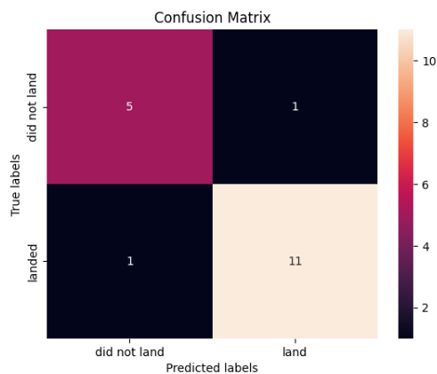
Confusion Matrix
he confusion matrix for the best-performing model, the Decision Tree (88.89% accuracy), shows the distribution of correctly and incorrectly classified instances. It helps to evaluate how well the model distinguishes between successful and failed outcomes:
True Positives (TP): Cases where the model correctly predicted success.
True Negatives (TN): Cases where the model correctly predicted failure.
False Positives (FP): Cases where the model incorrectly predicted success (actual outcome was failure).
False Negatives (FN): Cases where the model incorrectly predicted failure (actual outcome was success).
This provides insight into the model's strengths and weaknesses beyond accuracy.

Slide 45
Conclusions
Point 1: The Decision Tree model demonstrated the highest classification accuracy (88.89%), making it the most reliable predictor for Falcon 9 landing success compared to Logistic Regression, SVM, and KNN models.
Point 2: Successful landing outcomes are influenced by the payload mass, with a clear correlation between moderate payload ranges and higher success rates, especially with newer booster versions.
Point 3: Launch sites, particularly those beginning with "CCA" (Cape Canaveral), were pivotal for SpaceX launches, as they were frequently used and had relatively high success rates.
Point 4: The proximity of launch sites to coastlines, highways, and railways offers logistical advantages, with most successful launches occurring from well-positioned sites like Cape Canaveral, which had an important role in mission successes.

Slide 46
Appendix
For full Python code snippets, SQL queries, charts, and outputs, visit the project repository's README:
GitHub Repository - Falcon 9 Landing Prediction

Slide 47


